Slide 1


Using Eye Tracking for Gathering Attention Data
Complex Computer Rendering Methods in Real-Time
Ioh Nishijima
Yong Thorvue

Slide 2
Agenda
1. Visual attention & Eye Tracking
2. Eye Tracking in Marketing Research
3. Related Work
4. Project purpose
5. Progress & future agenda
6. Demonstration

Slide 3



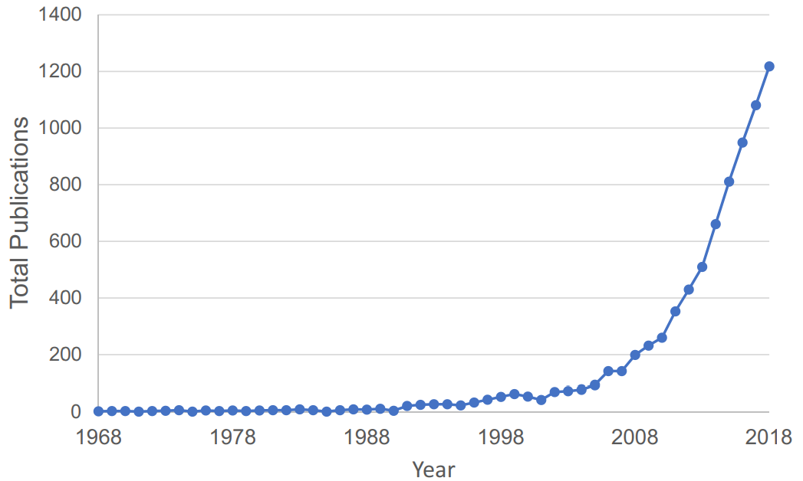
Visual attention
Visual attention is one of the most important in many situation of life
Surgery
Drawing
Driving
Eye tracking
Psychology and Cognitive Science
Human-Computer Interaction (HCI)
Market Research and Advertising
Neuroscience and Neuroergonomics
Medical and Clinical Applications
Number of publications per year of TOPIC: “eye tracking” Carter, B. T., & Luke, S. G. (2020)

Slide 4
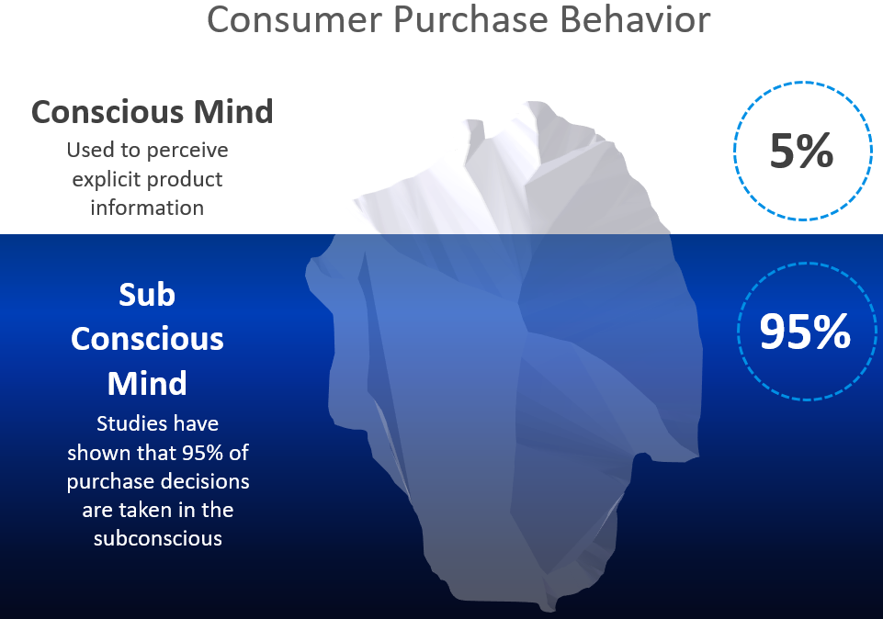
Eye-Tracking in Marketing Research
Calvert and Brammer stated that 95% of purchase decisions happen in the subconscious mind
Eye-Tracking is essentially a window to understand people’s behaviour and assess what is going on in the subconscious.
Calvert, G. A., & Brammer, M. J. (2012)

Slide 5

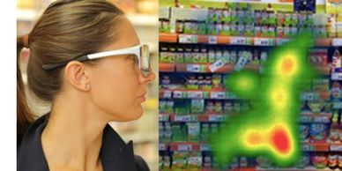
Eye-Tracking in Marketing Research
Using the eye-tracking in marketing research is the intention to understand the actions of consumers
Visual attention is essential in examining consumer behavior and understanding its role in the decision-making process can provide valuable knowledge that enables to effectively design marketing activities using visual messages
The goal of marketing activities is to provide consumers with product information in an efficient enough way to increase awareness among potential buyers and to identify the needs that can be met through it. Consequently, awareness of product availability increases the likelihood of buying it

Slide 6

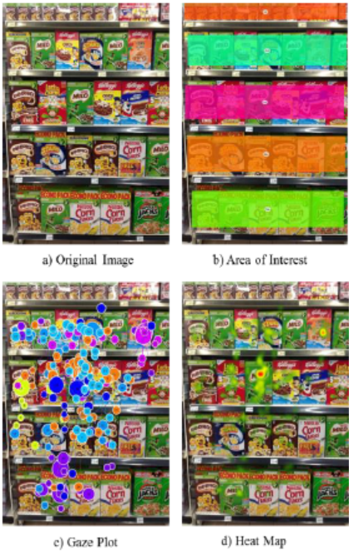
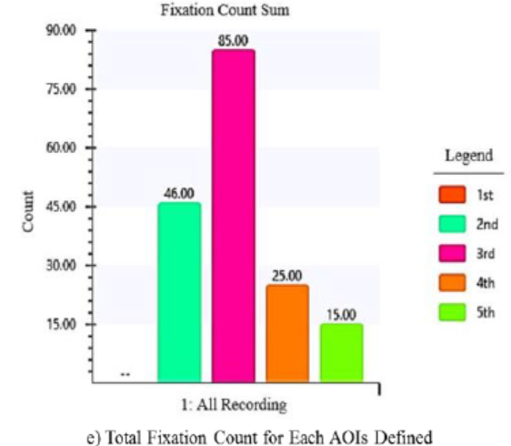
Problem:
Using Tobii eye tracking, The participants have to stable without movement during experiment (i.e. look at display)
2D images lack some information of the products
Participant observers are more likely to shift their gaze to such visually salient features (e.g. center of screen..)

Slide 7

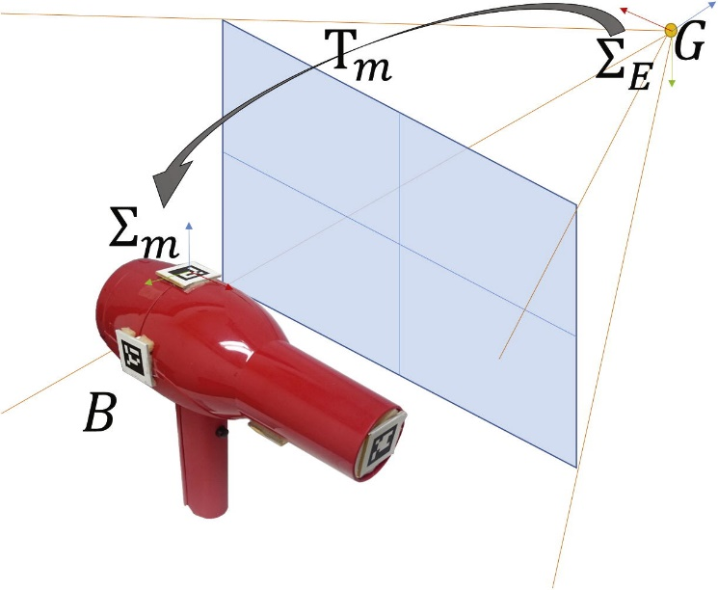
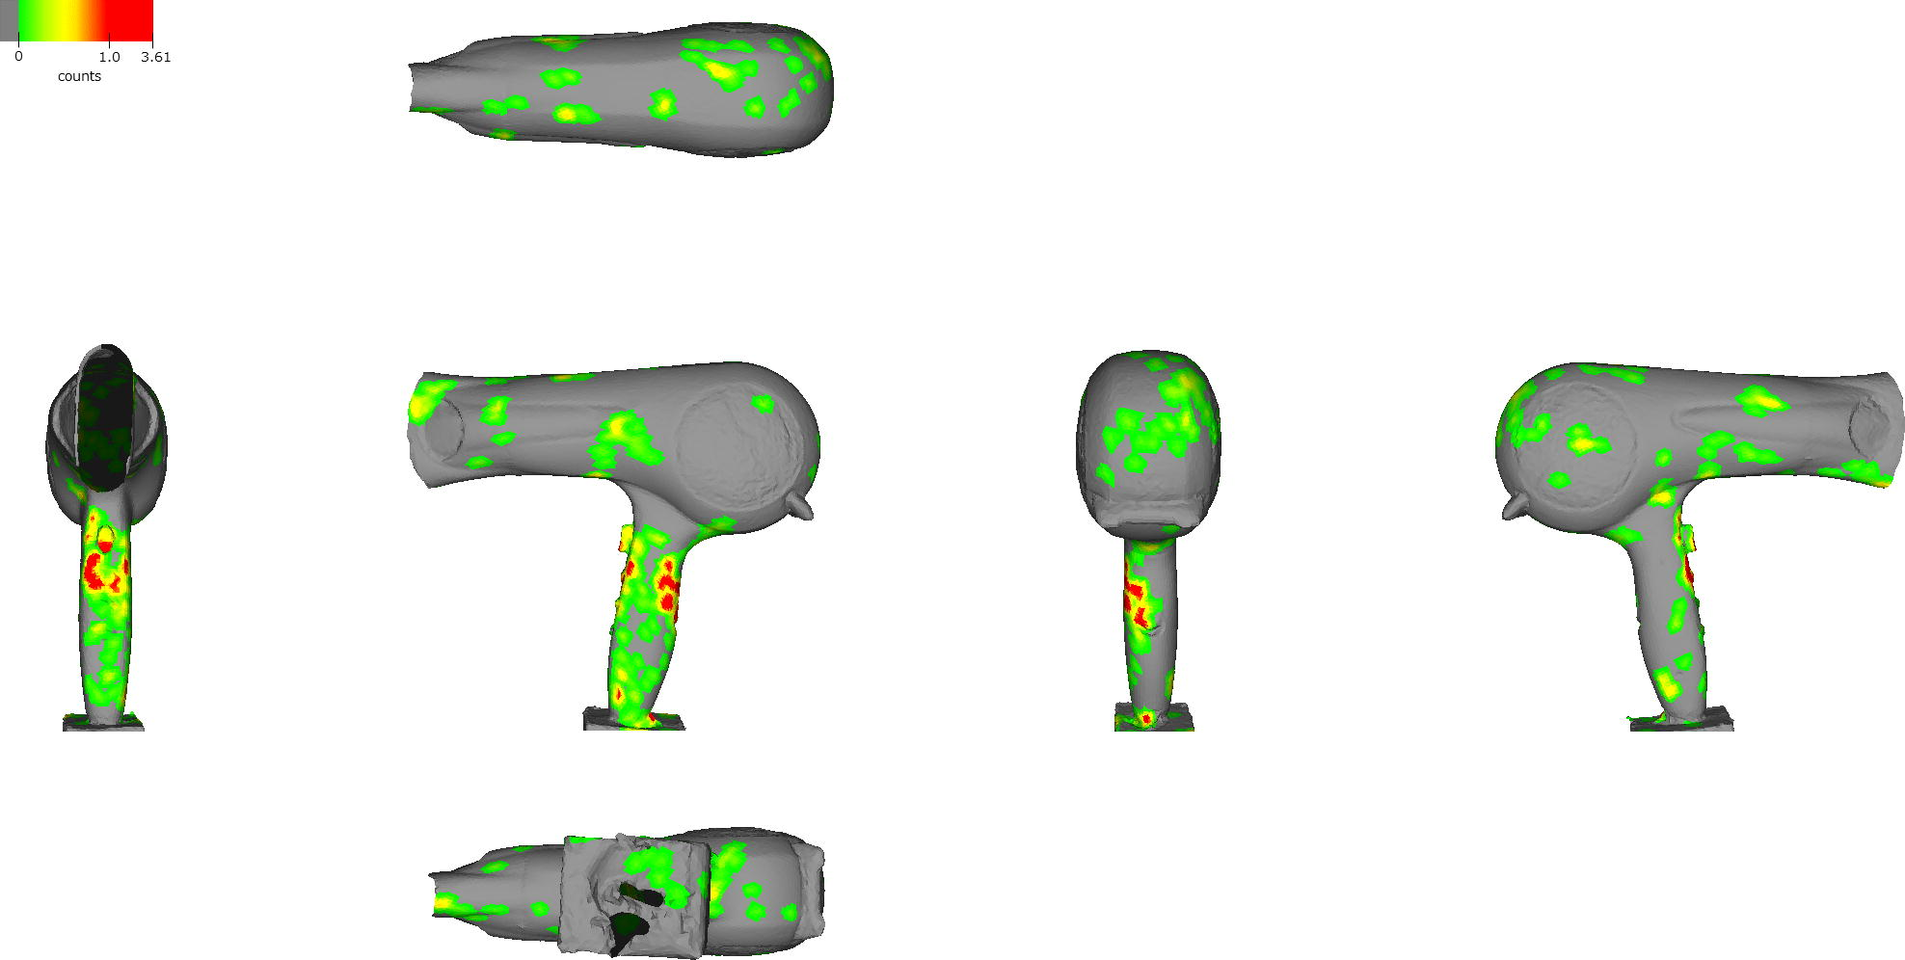
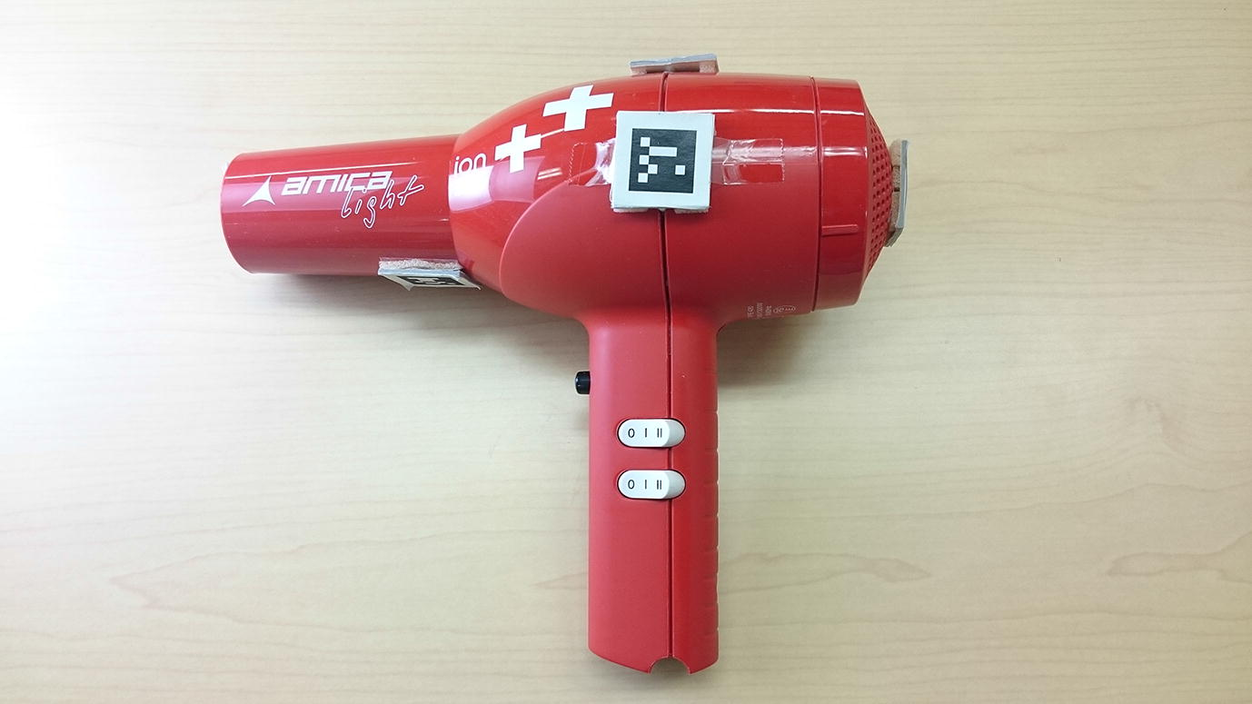
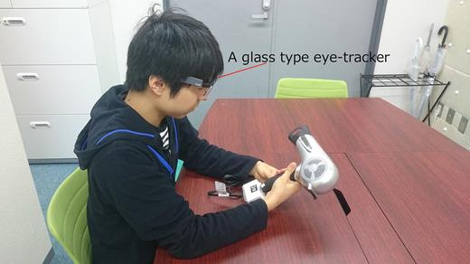
AR markers
Experiment
Visualizing the attention data using AR maker to calculate position and posture of given products
Results
Problem:
Using AR markers greatly affect the product’s outlook to draw attention of users.
Visualization of gaze direction, location, and time. Here, gaze direction should be informative, but it is not visualized in current implementation.

Slide 8
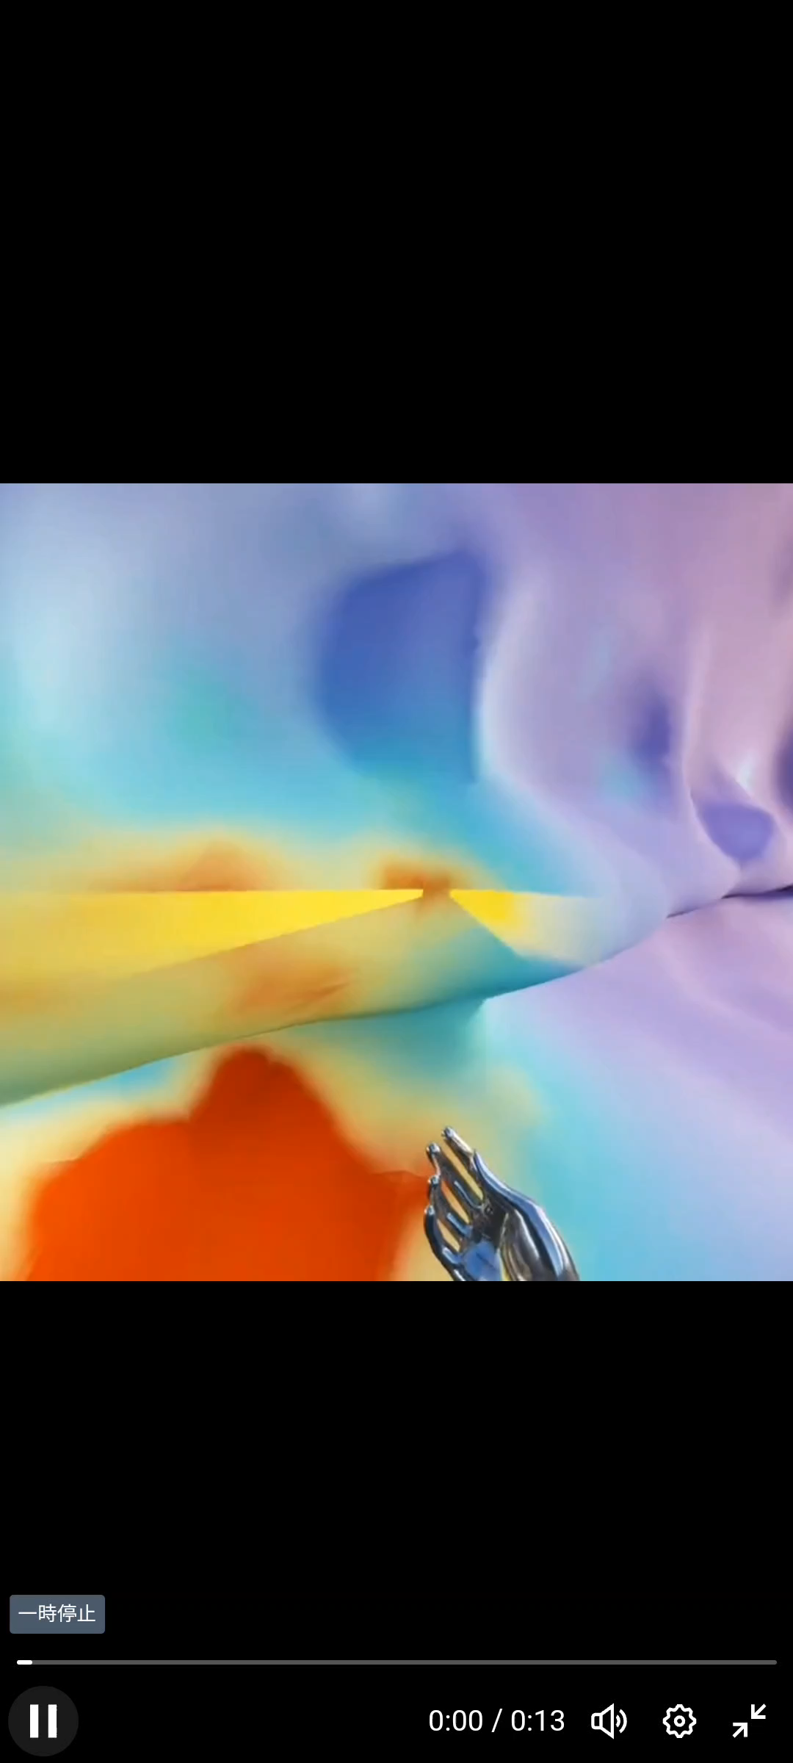
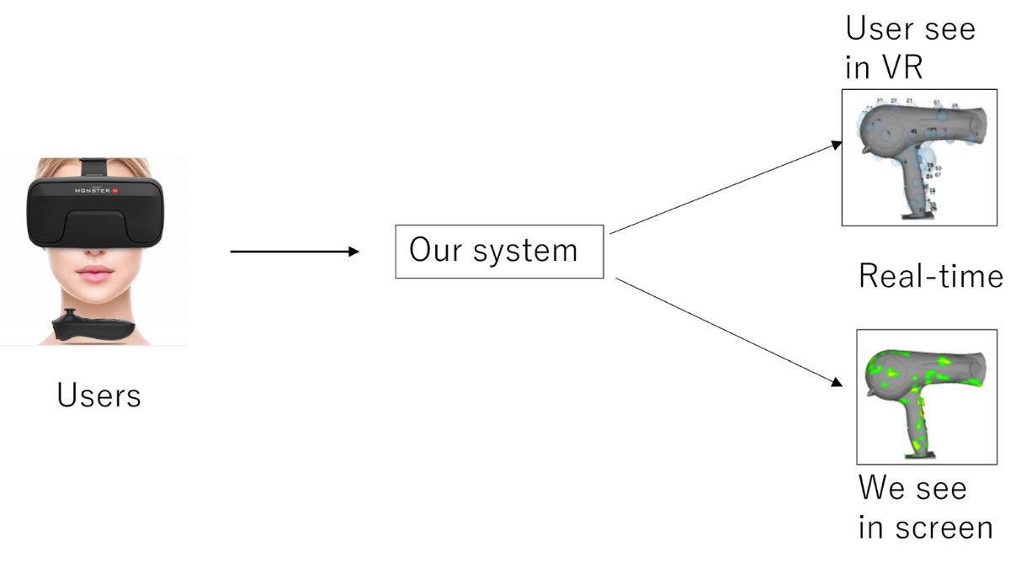
Goal
Using Eye Tracking Feature on Quest pro headset for gathering and visualization attention data of users in VR environment.
Source: https://twitter.com/StrangeNative/status/1592561315108728832?s=20

Slide 9
Initial Process
1. Acquisition of UV coordinates via gaze detection (2D) in unity scene by using eye tracking feature on Quest Pro.
2. Real-time Visualization of gaze data using Shader (2D)
3. Object grabbing using hand tracking (3D)
4. Acquisition of UV coordinates via gaze detection (3D)
5. Real-time visualization of gaze using shaders (3D)
6. Saving UV coordinates to a CSV
7. Visualizing the gaze data using the CSV in other tools

Slide 10
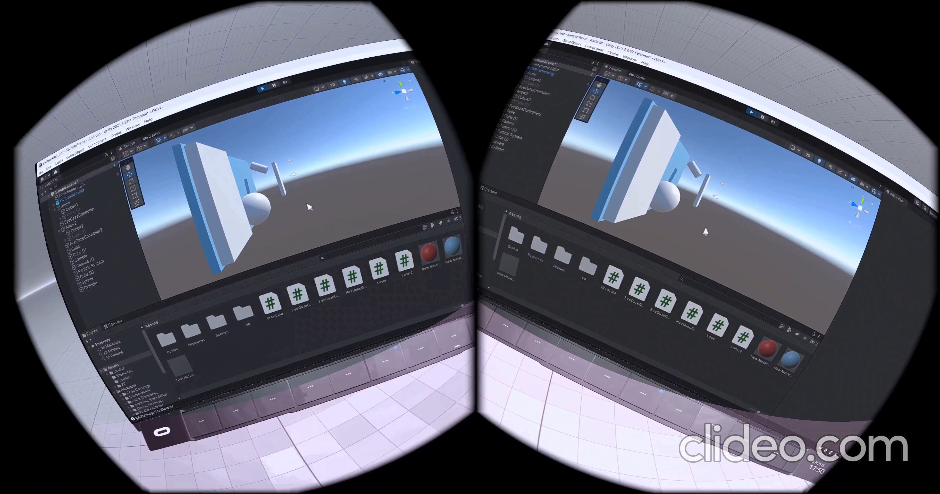
Progress
Eye tracking setup
Data extraction(X, Y, Z)
Visualize attention data in real-time
Notes:
So far, we have enabled Eye Tracking using Unity and Quest Pro, and saved the Eye Tracking data as a CSV file. We've also visualized gaze data in real time within a VR environment. As you can see in the video, the pink line represents the gaze and particles are generated on the surface of objects, which allows us to visualize where people are look at.

Slide 11
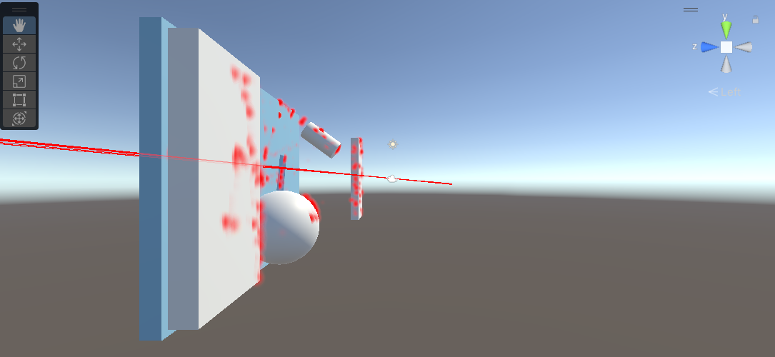
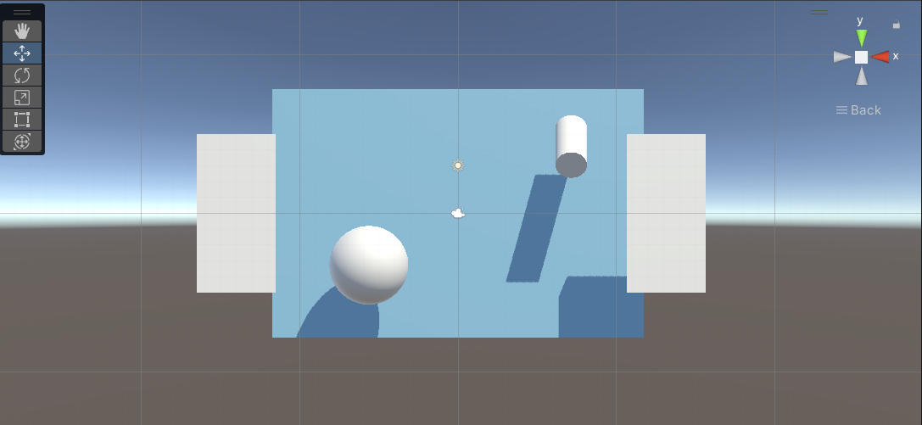
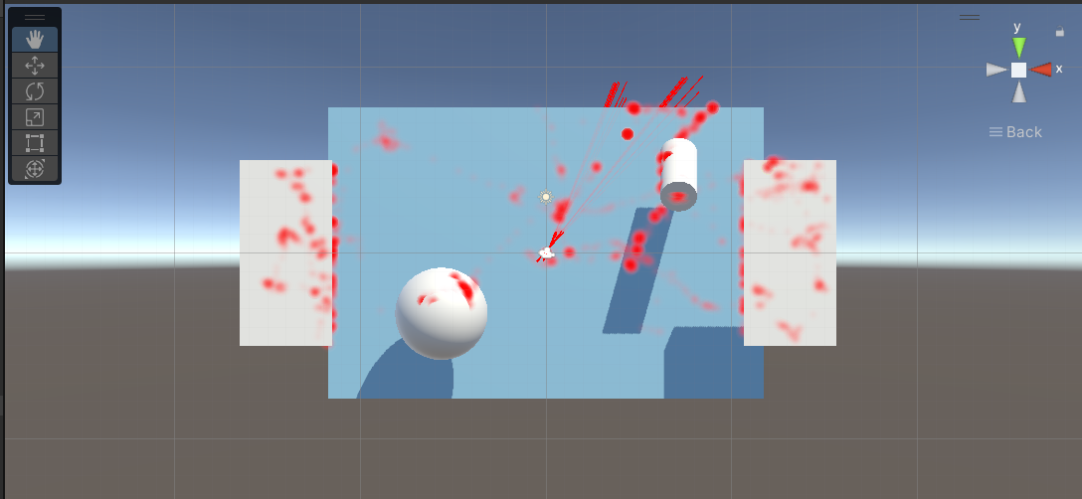
Progress
Notes:
We've been able to record where the gaze is focusing in 3D space, as you can see in images.

Slide 12
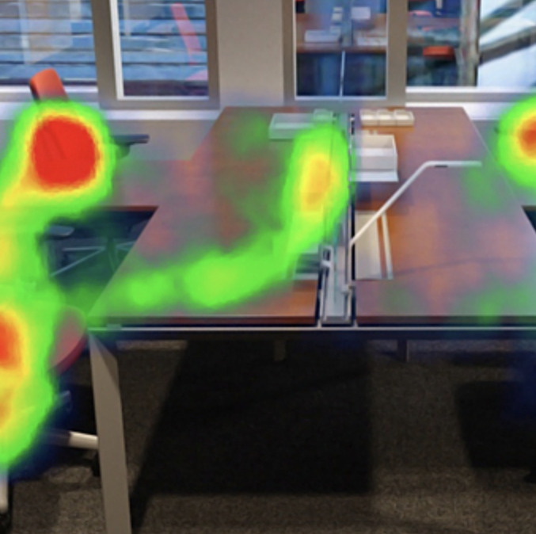
Future agenda
Improve the clarity and visual information of heatmaps
Create heatmaps from CSV data(not real time)
Create Virtual world in Unity

Slide 13
Demonstration

Slide 14
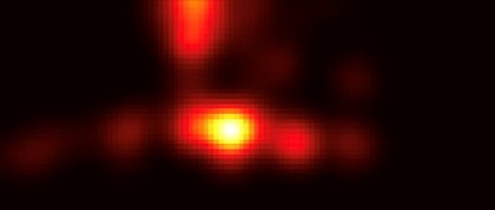
Heat map using python

Slide 15
What we have done
Acquisition of UV coordinates via gaze detection (2D) in unity scene by using eye tracking feature on Quest Pro. ​
Real-time Visualization of gaze data using Shader (2D)​
Object grabbing using hand tracking (3D)​
Acquisition of UV coordinates via gaze detection (3D)​
Only with no rigid body​
Real-time visualization of gaze using shaders (3D)​
Saving UV coordinates to a CSV​
Visualizing the gaze data using the CSV in other tools

Slide 16
Problem
When using Rigid Body, UV coordinates cannot be obtained through collision detection using RayCast (cause unknown)
Using Rigid Body is essential for lifting objects

Slide 17
Future work
Solving the issue of not being able to obtain UV coordinates from objects with attached Rigid Body
Real-time visualization of gaze on 3D objects using shaders

